Slide 1
Holding Students Accountable
In a “cut and paste” world

Slide 2
PLEASE KEEP IN MIND…
This slide show outlines the process I use with high school students. It obviously must be adapted for use at younger grades.

Slide 3
In a Perfect World…
Teachers and librarian would present information and expectations. Students would shout “Hallelujah!”, thank us for our wisdom, and immediately internalize and act on that great wisdom.
Yeah right...

Slide 4
Reality Check

Slide 5
Steps to Accountability*
Choose a citation format and program. (If possible, make it consistent throughout the district)
Teach students the “whys and hows” of evaluating and citing.
Emphasize the need for reading and citing a variety of media, and for evaluating sources before using them. This Works Cited Rubric will be helpful.
* For convenience sake, I will reference EasyBib in my examples. It is the program I am most familiar with – but there are many other choices available to you.

Slide 6
Steps to Accountability
Break instruction into chunks according to type of media. (Encyclopedias, Reference Books, Books, Databases, and finally … Websites and more.
Demonstrate each major type of resource you want students to use.
Limit students to working with ONE major type of resource per period.

Slide 7
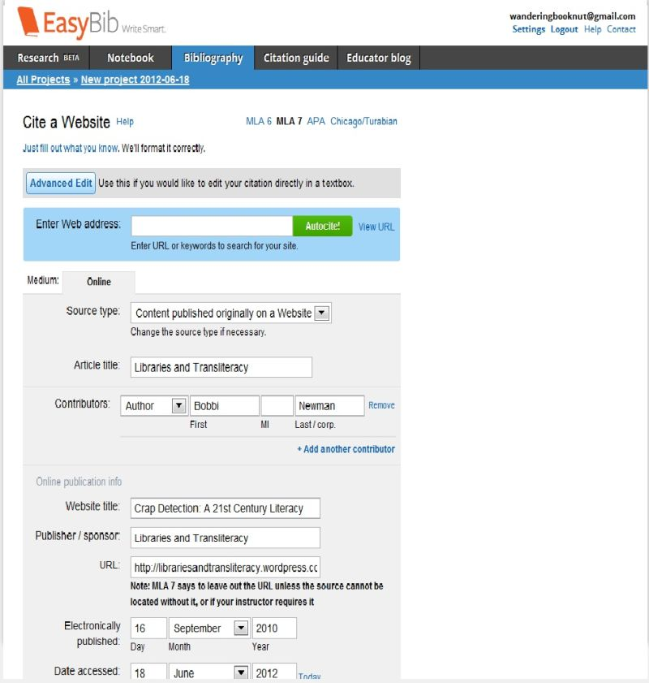
Steps to Accountability
Students complete the EasyBib form. They then print and hand in the detailed, editing page for their source(s) at the end of each period.

Slide 8
Steps to Accountability
Teacher and/or Librarian correct the editing page. Do NOT provide the right answer – simply indicate where the student has gone wrong, and suggest they see you asap. Where appropriate, be sure to indicate if the source is credible. If it is not, they must throw out that source and find another.
Grade each citation. I use a point system 5 points = a perfect EasyBib Editing Form.

Slide 9
Steps to Accountability
During the next period, require students to correct their citation. When done, students read their source and begin the note-taking process. It is helpful to have graphic organizers and other forms to help with this process.
If you have Premium EasyBib – there is an awesome note-taking and outlining option. Other citation programs offer similar features.

Slide 10
Steps to Accountability
Maintain a grade book to keep students on track. (Our teachers include my grades in their final project grade.)

Slide 11
Steps to Accountability
Have students turn in their completed works cited list to you online, so that you can use your word processing program to make corrections more easily.
Give a final grade on the completed works cited list. Feel free to use my works cited rubric which grades on a percentage basis. Notice that the Works Cited Rubric puts more emphasis on the quality of the resources used than on the positioning of commas, quotes etc.

Slide 12
Sound Intimidating?
I won’t try to fool you. It is WORK! But…the pay-off is worth the effort. As students progress through the grades, it will become easier for them.
…And hopefully they will not be quite so “gob-smacked” when they get into a college class that demands scholarly research skills.

